Slide 1
GEOSPATIAL ANALYSIS FOR WATERSHED SELECTION IN PISHIN RIVER BASIN REVIVAL OF BALCOHISTAN WATER RESOURCES PROGRAMME 2022
MEHWISH ALI
AREESHA ASGHAR
17 August 2022

Slide 2
OUTLINE
1- Pishin Basin
Map of Pishin Basin
Population
Land cover
Topography
Rainfall
2- GIS based Watershed selection in Pishin Basin
Summary of selection criteria
Potential For Ground Water Recharge
Potential For Surface Water Harvesting
Potential For Livestock Based Interventions
3- Combined Results
Summary of selection criteria
Resultant Map

Slide 3
PISHIN BASIN

Slide 4
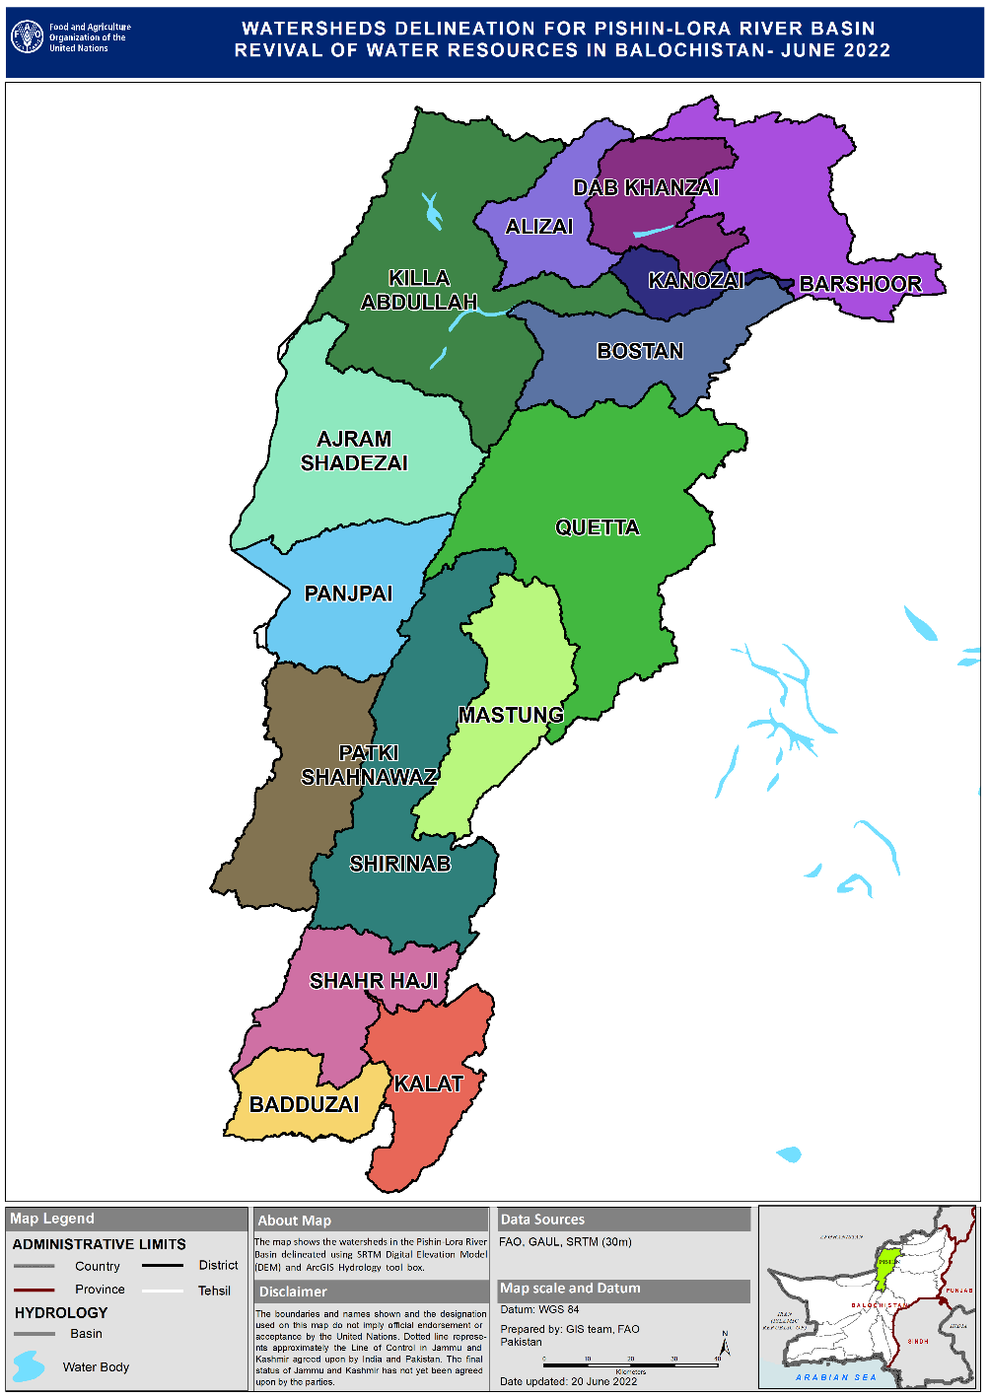
PISHIN BASIN MAP
WATERSHED NAMES

Slide 5
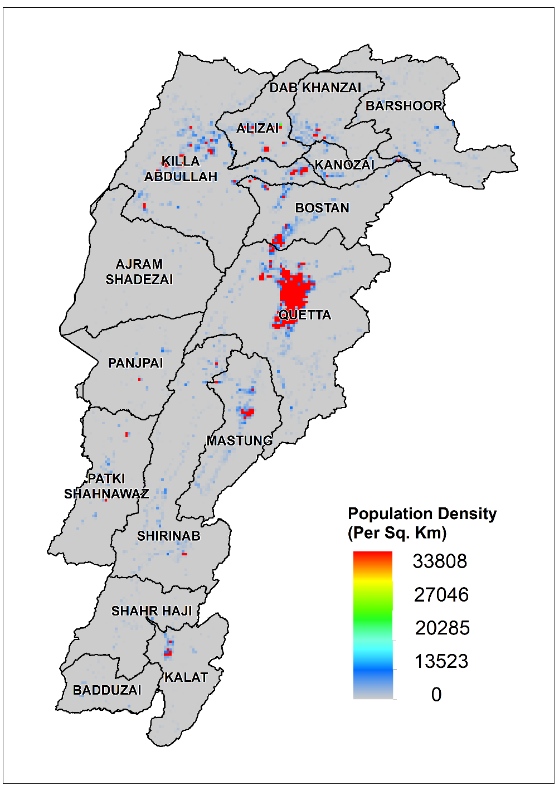
POPULATION DENSITY MAP
POPULATION MAP - PISHIN
Total Population = 2,994,200

Slide 6
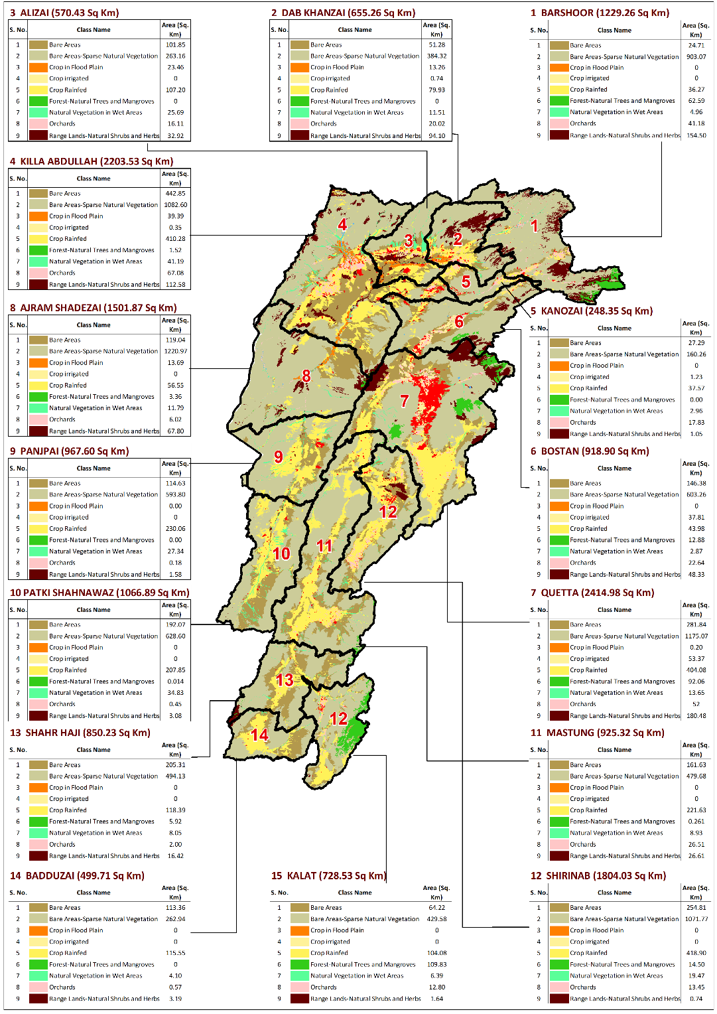
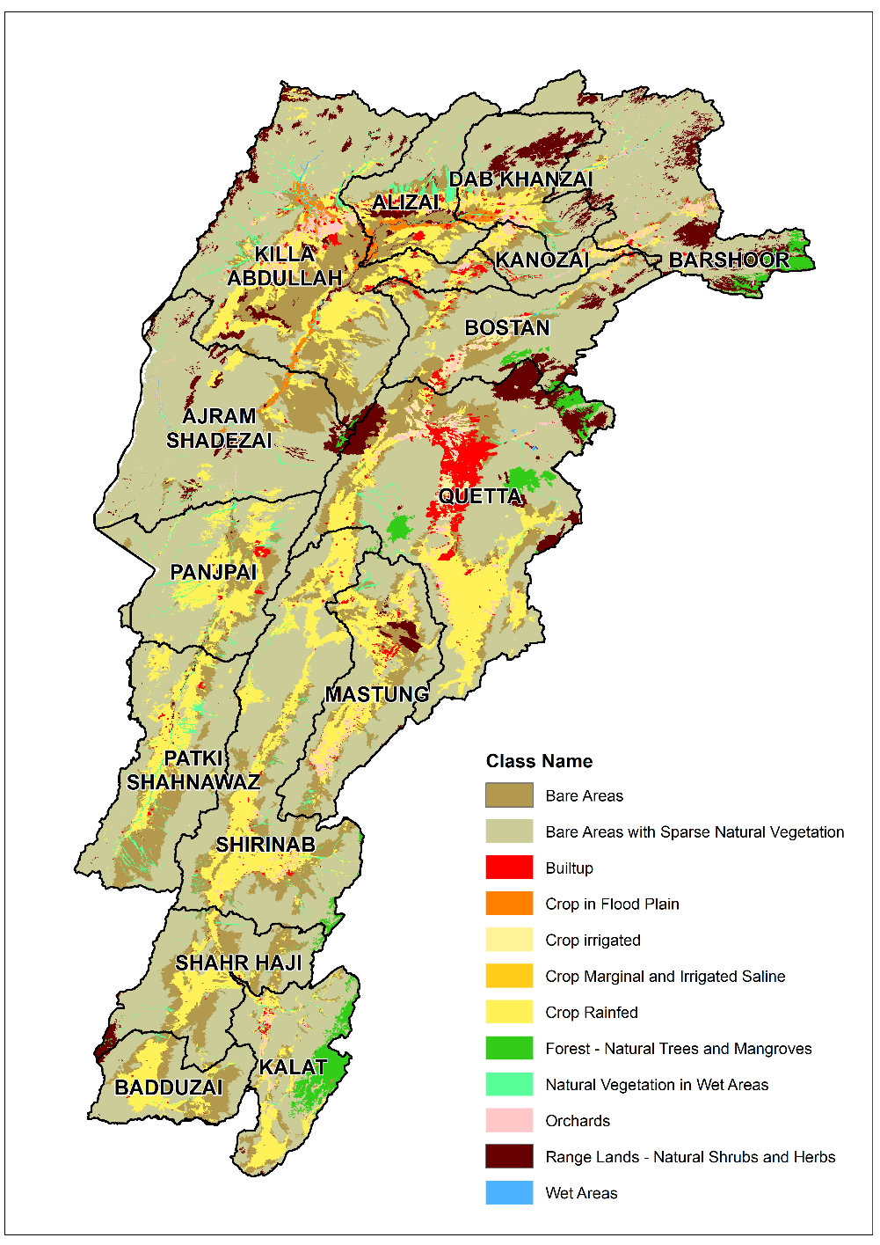
LAND COVER STATISTICS OF PISHIN BASIN
LAND COVER

Slide 7
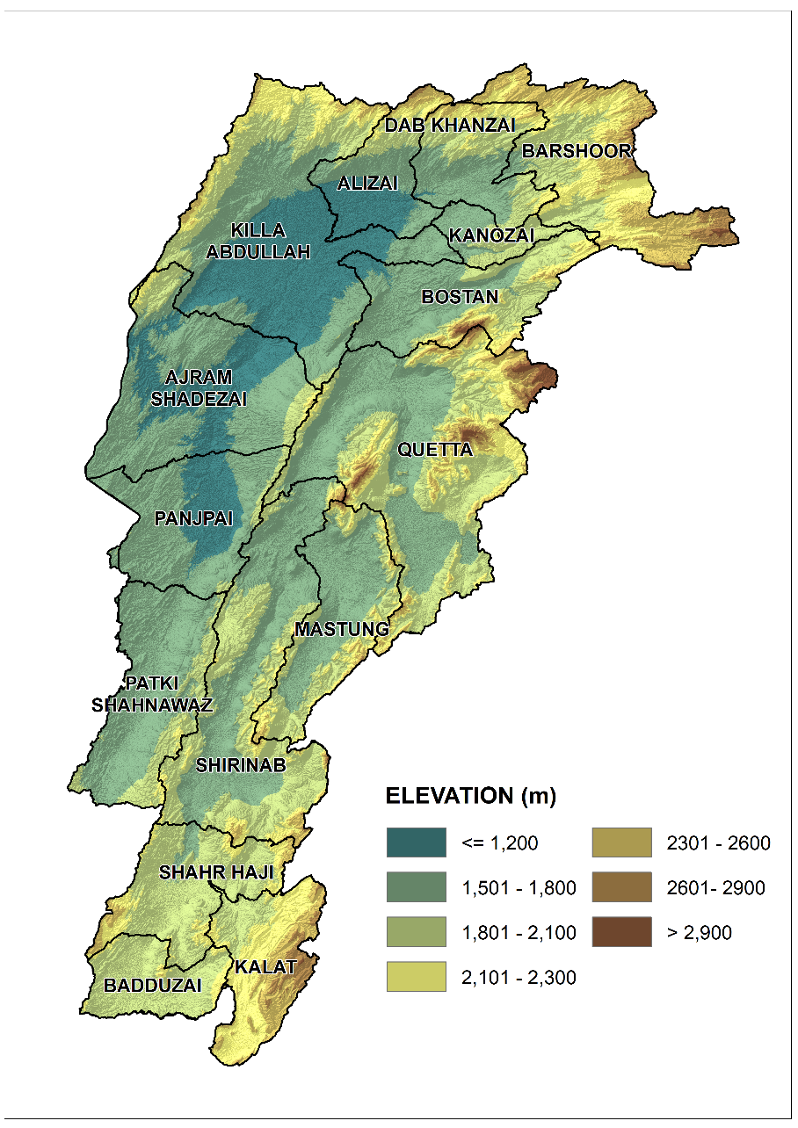
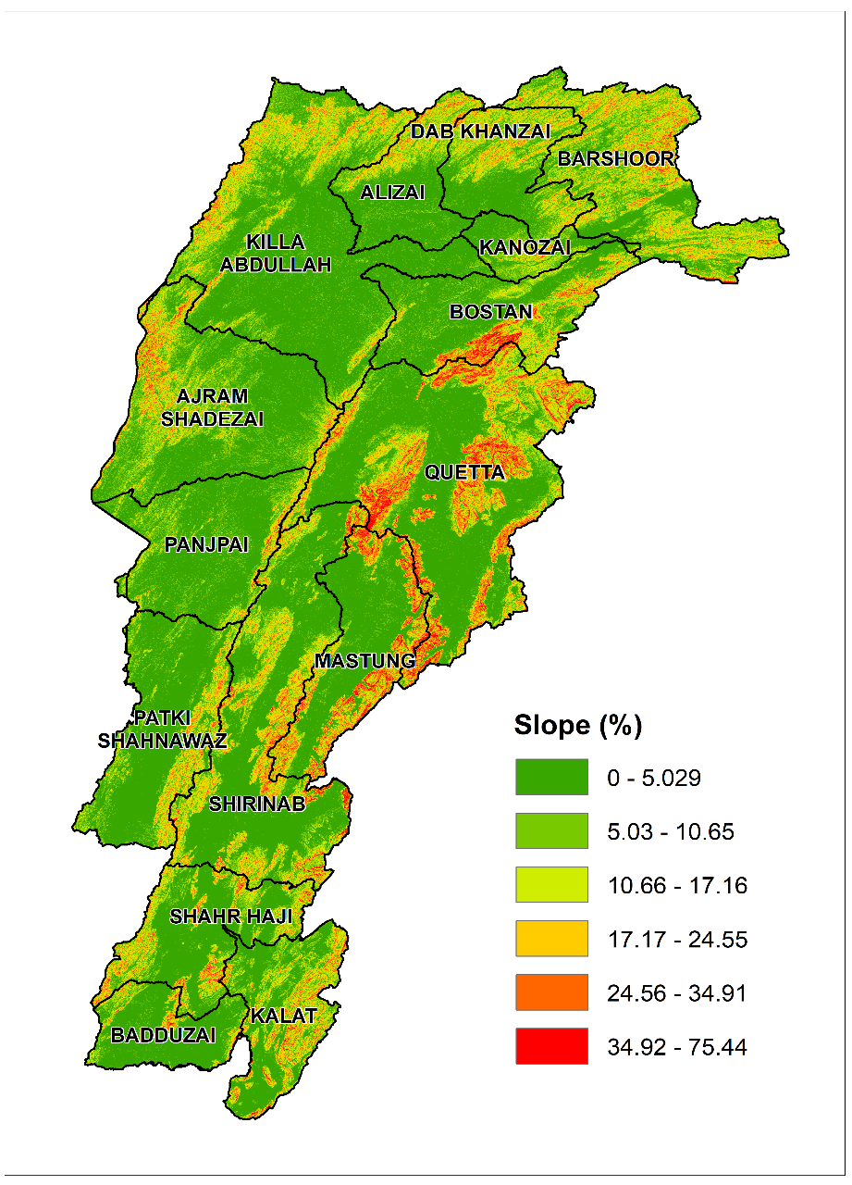
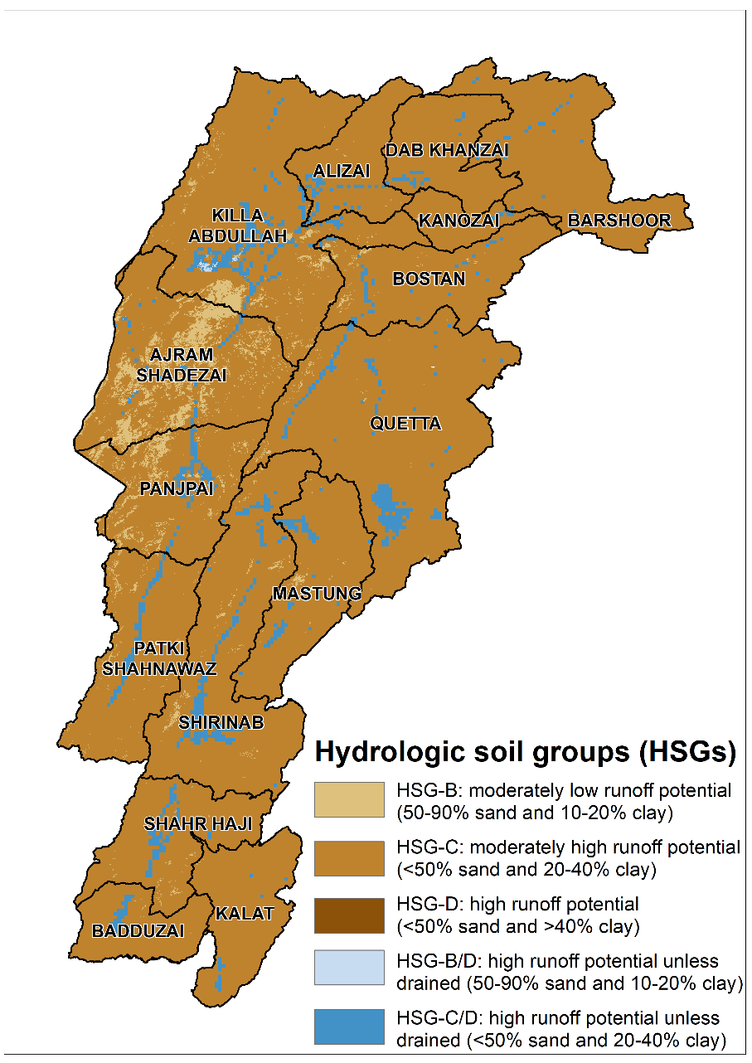
LAND TOPOGRAPHY - PISHIN BASIN
ELEVATION
SLOPE
HYDROLOGIC SOIL GROUPS

Slide 8
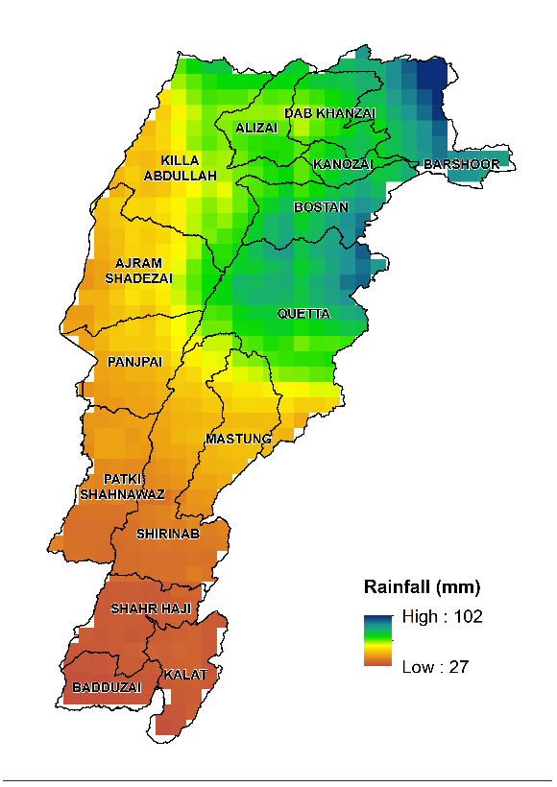
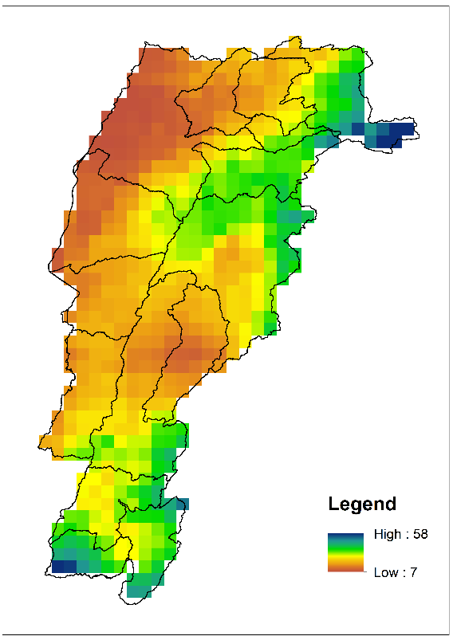
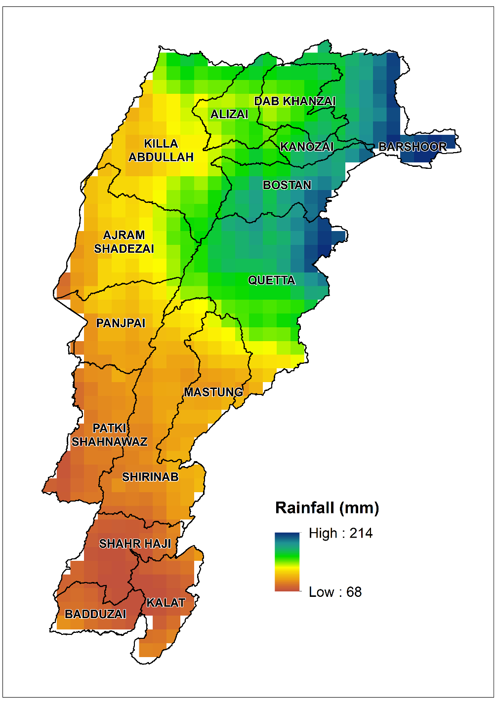
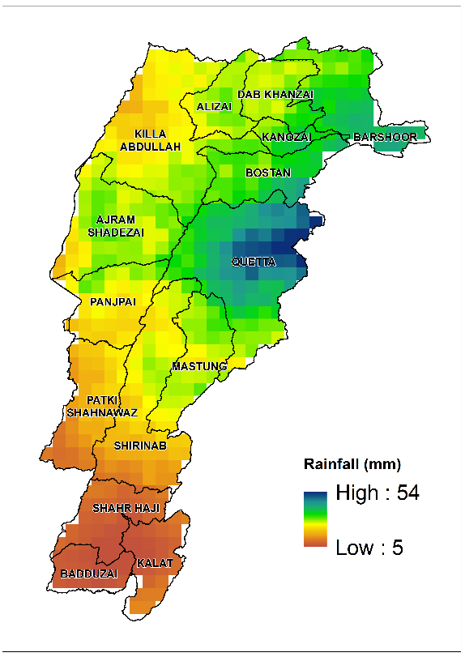
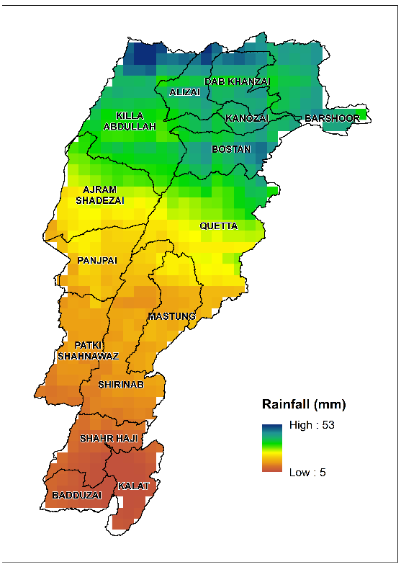
ANNUAL RAINFALL- PISHIN BASIN
Q1 2021 (mm)
Q3 2021 (mm)
ANNUAL RAINFALL (mm)
Q2 2021 (mm)
Q4 2021 (mm)

Slide 9
GIS based Watershed selection in Pishin Basin

Slide 10
CRITERIA | INDICATOR (watershed level) | WEIGHTAGE/INFLUENCE | OVERALL WEIGHT
Potential for Ground Water Recharge | Average annual Rainfall (as an indicator of Water availability) | 60% | 25%
 | Area under Rangelands (sq.km) | 20%
 | Area under Wetlands (sq.km) | 20%
 | Total | 100%
Potential for Surface Water harvesting | Average annual rainfall for 20 years (mm) | 70% | 25%
 | Run-off potential based on soil texture | 20%
 | Population density | 10%
 | Total | 100%
Potential For Livestock Based Interventions | Area under rangelands (sq.km) | 60% | 50%
 | Livestock Density | 30%
 | Condition of vegetation | 10%
 | Total | 100%

Slide 11
MAPPING POTENTIAL FOR GROUND WATER RECHARGE

Slide 12
MAPPING POTENTIAL FOR GROUND WATER RECHARGE
Average annual rainfall for 20 years (2001-2021)
Area under rangelands (sqkm)
Area under wetlands (sqkm)

Slide 13
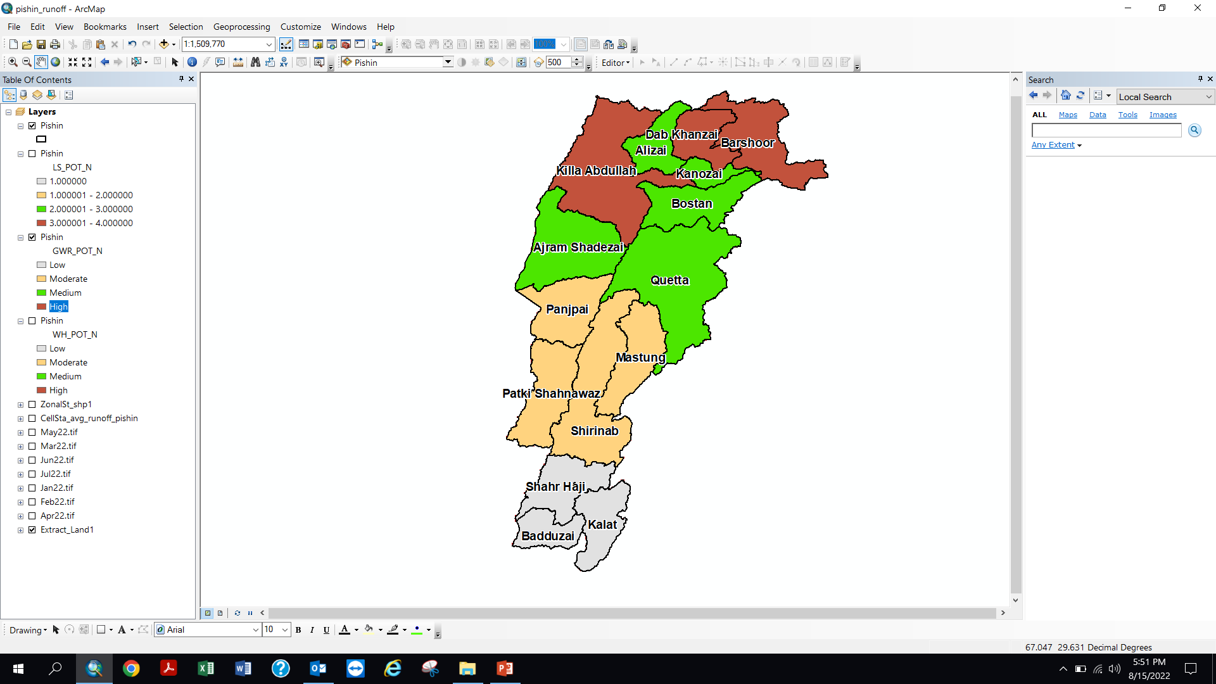
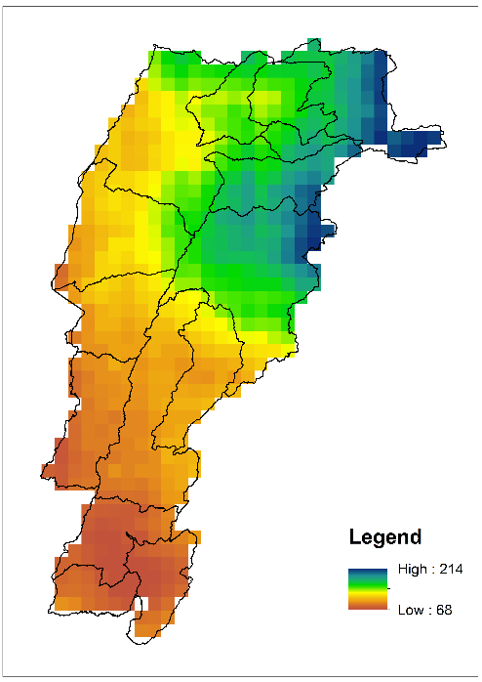
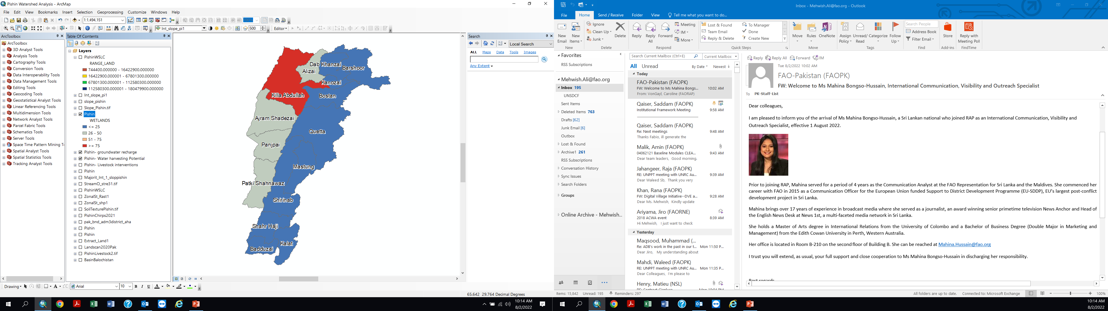
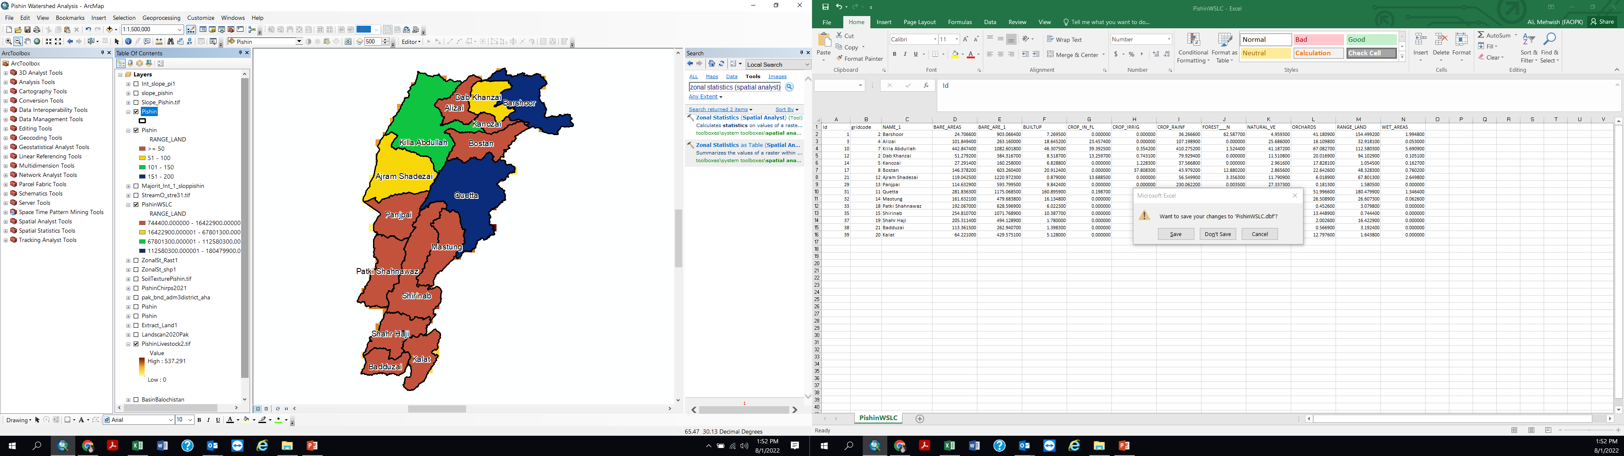
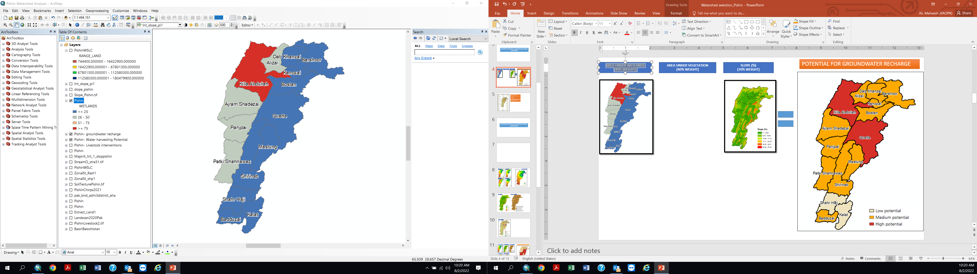
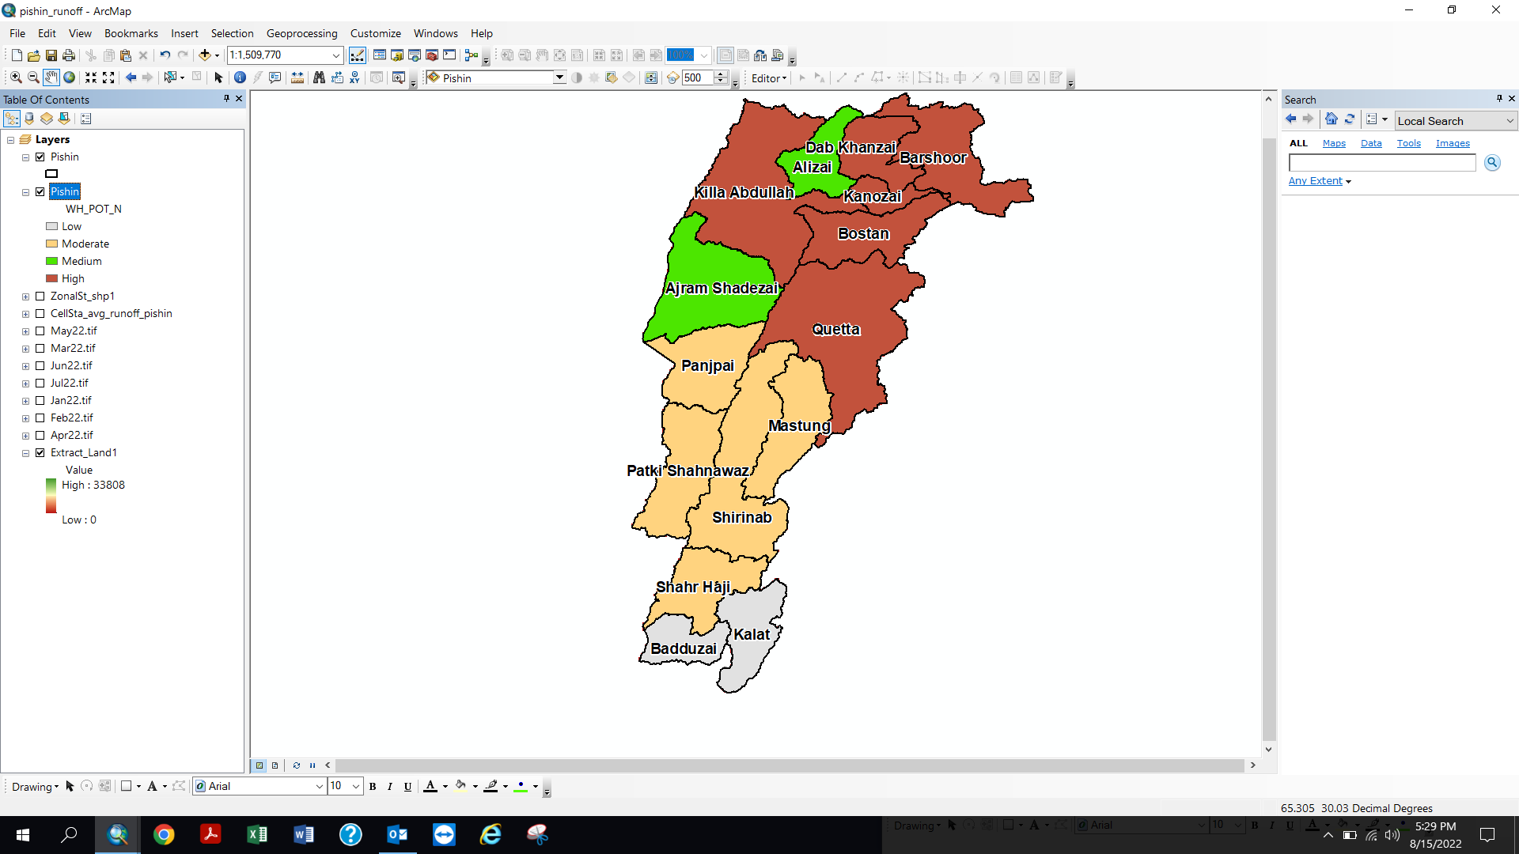
AREA UNDER WETLANDS (sq km)
POTENTIAL FOR GROUNDWATER RECHARGE
RAINFALL (mm)
AREA UNDER RANGELANDS
(sq km)
Area (Sq. km)
Rainfall (mm)
INDICATOR (WATERSHED LEVEL) | WEIGHTS | DATA SOURCE
AVERAGE RAINFALL | 60% | CHIRPS Satellite Data
AREA UNDER WETLANDS | 20% | FAO,SUPARCO
AREA UNDER RANGELANDS | 20% | FAO,SUPARCO

Slide 14
MAPPING POTENTIAL FOR SURFACE WATER HARVESTING

Slide 15
MAPPING POTENTIAL FOR SURFACE WATER HARVESTING
Average annual rainfall for 20 years (2001-2021)
Amount of run-off generated
Population density

Slide 16
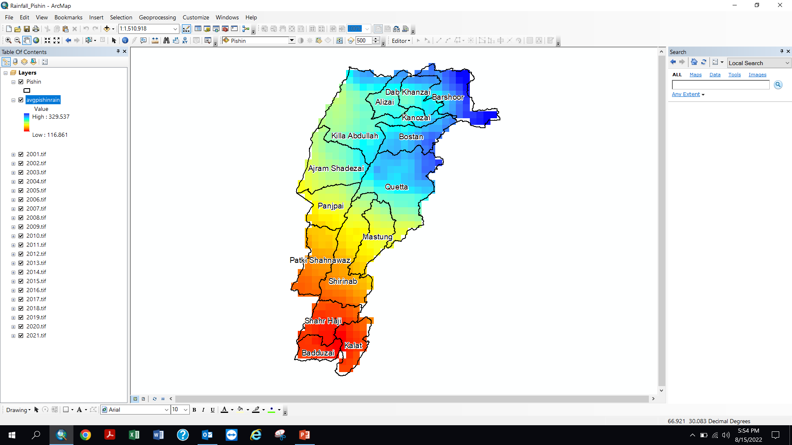
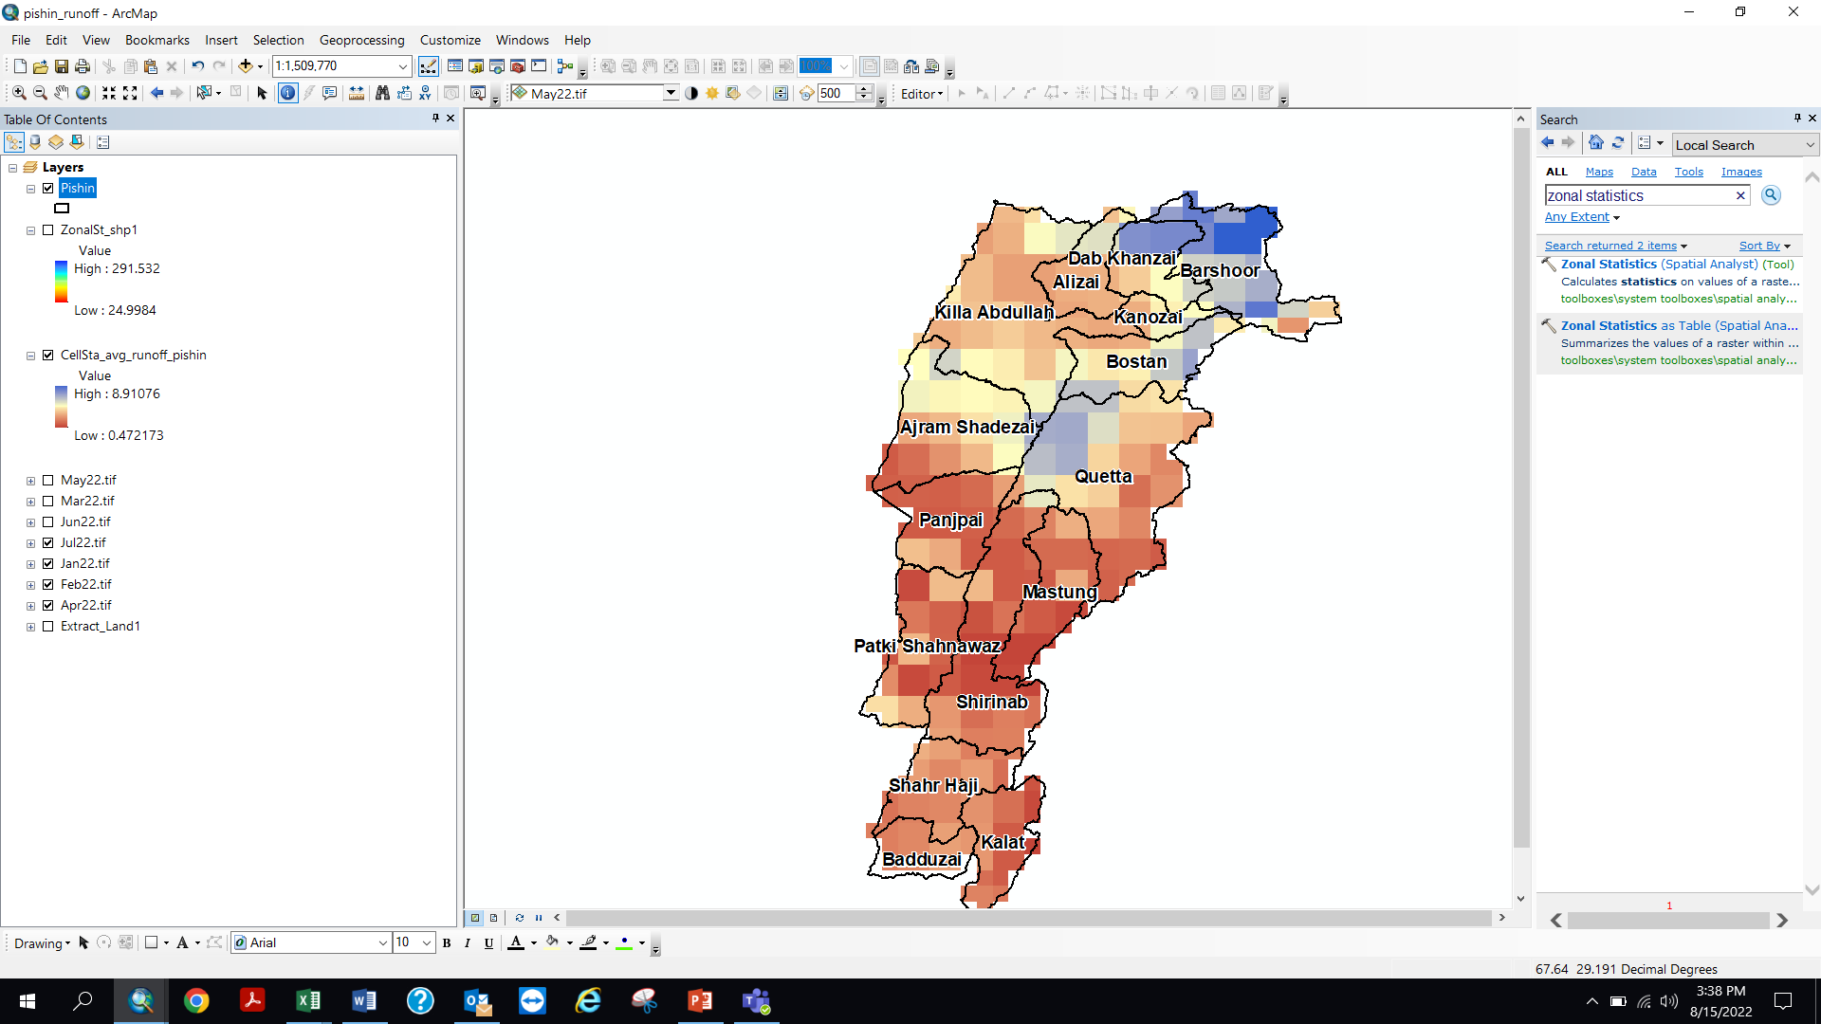

MONTHLY RUNOFF (mm)
POTENTIAL FOR SURFACE WATER HARVESTING
AVERAGE ANNUAL
RAINFALL (mm)
POPULATION
DENSITY (Per Sq. Km)
Rainfall (mm)
Runoff (mm)
INDICATOR (WATERSHED LEVEL) | WEIGHTS | DATA SOURCE
RAINFALL (2001-2021) | 70% | CHIRPS Satellite Data
RUNOFF | 20% | FEWSNET
POPULATION DENSITY | 10% | LANDSCAN 2020

Slide 17
MAPPING POTENTIAL FOR LIVESTOCK BASED INTERVENTIONS

Slide 18
MAPPING POTENTIAL FOR LIVESTOCK BASED INTERVENTIONS
Livestock density
Availability of natural fodder, scope for value addition to the livestock sector/area under rangelands
Condition of rangelands

Slide 19
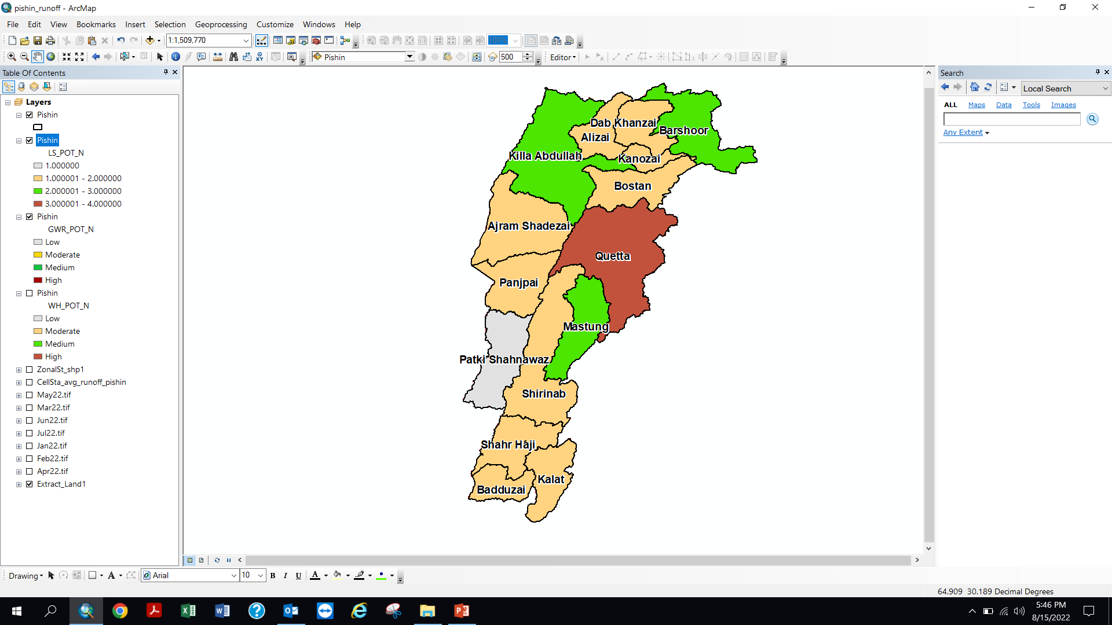
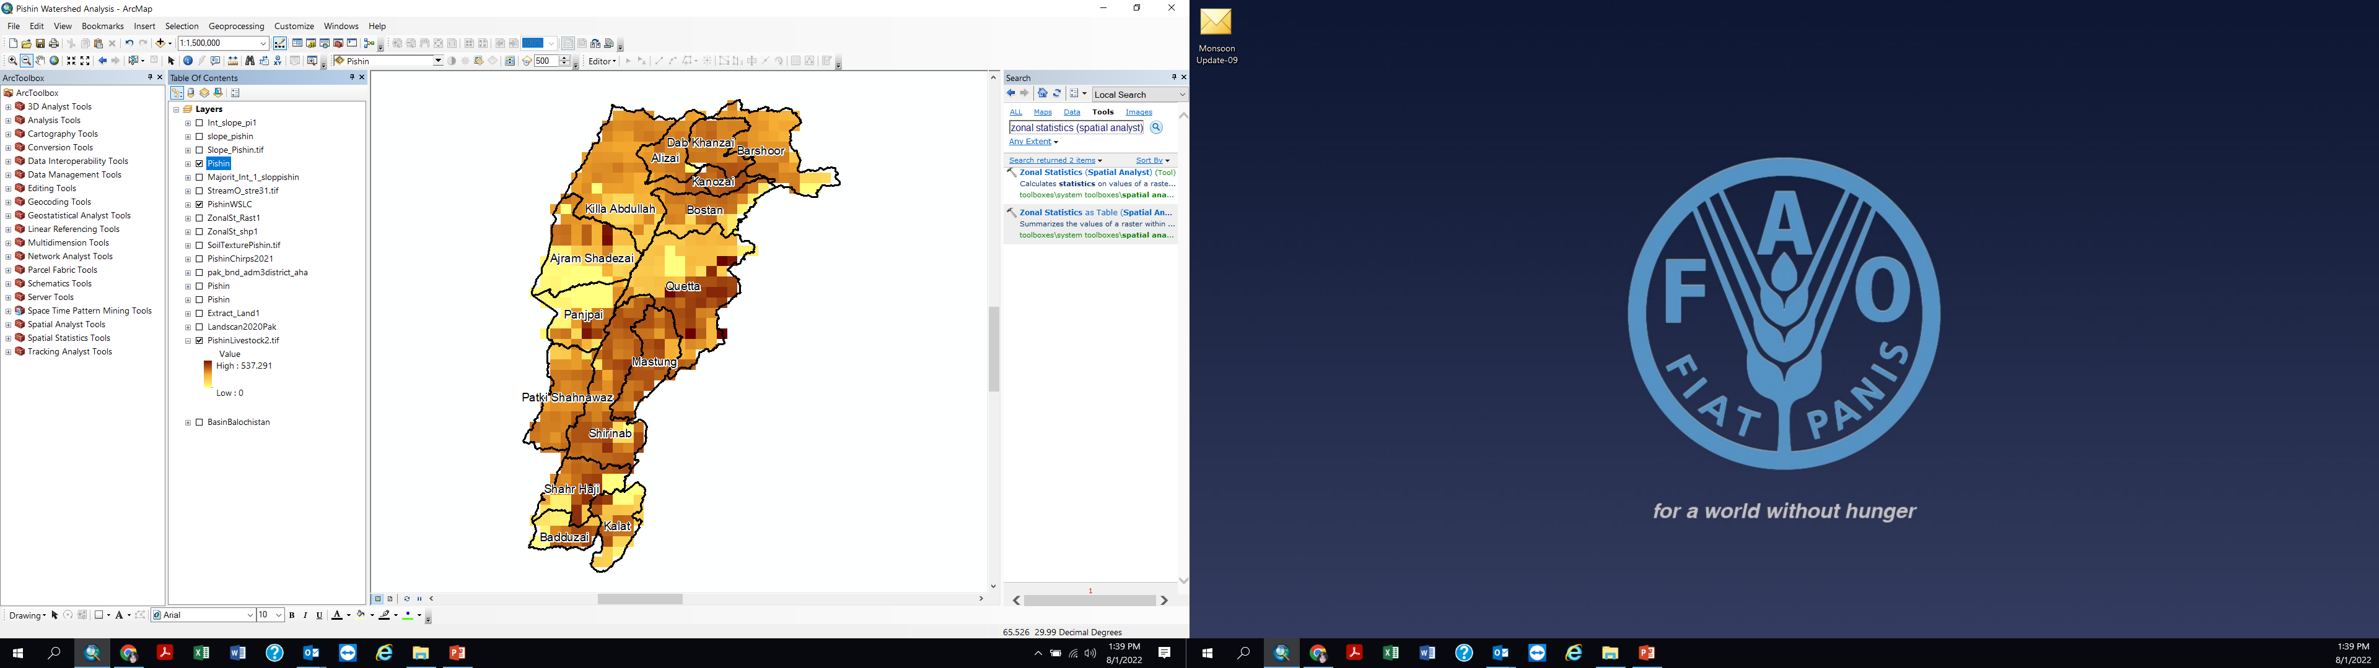
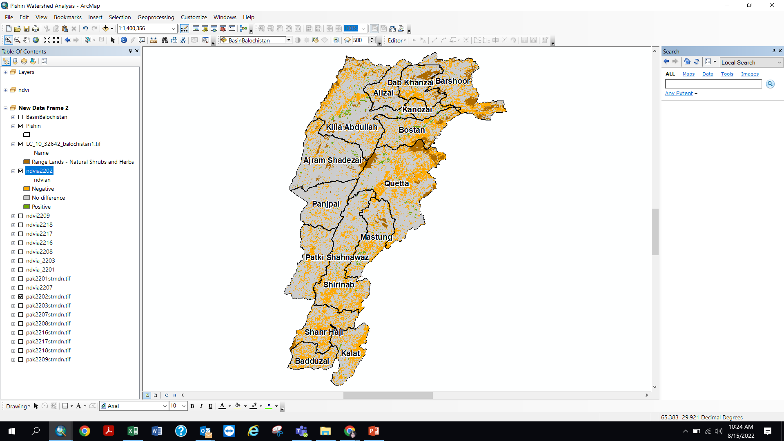
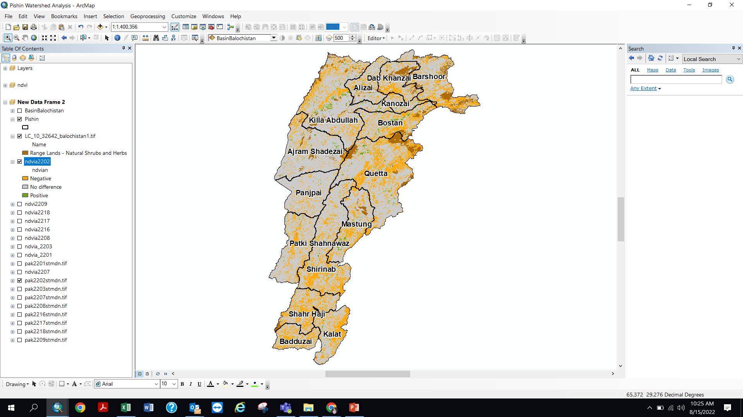
AREA UND. RANGELANDS (Sq. KM) (60% WEIGHT)
POTENTIAL FOR LIVESTOCK BASED INTERVENTIONS
LIVESTOCK DENSITY
(30% WEIGHT)
CONDITION OF RANGELANDS
(10% WEIGHT)
Rangelands
Current Condition of
Vegetation based on NDVI
INDICATOR (WATERSHED LEVEL) | WEIGHTS | DATA SOURCE
AREA UNDER RANGELANDS | 60% | FAO, SUPARCO
LIVETSOCK DENSITY | 30% | FAO
CONDITION OF RANGELANDS | 10% | FEWSNET, MODIS

Slide 20
COMBINED RESULT

Slide 21
CRITERIA | INDICATOR (watershed level) | WEIGHTAGE/INFLUENCE | OVERALL WEIGHT
Potential for Ground Water Recharge | Average annual Rainfall (as an indicator of Water availability) | 60% | 25%
 | Area under Rangelands (sq.km) | 20%
 | Area under Wetlands (sq.km) | 20%
 | Total | 100%
Potential for Surface Water harvesting | Average annual rainfall for 20 years (mm) | 70% | 25%
 | Run-off potential based on soil texture | 20%
 | Population density | 10%
 | Total | 100%
Potential For Livestock Based Interventions | Area under rangelands (sq.km) | 60% | 50%
 | Livestock Density | 30%
 | Condition of vegetation | 10%
 | Total | 100%

Slide 22
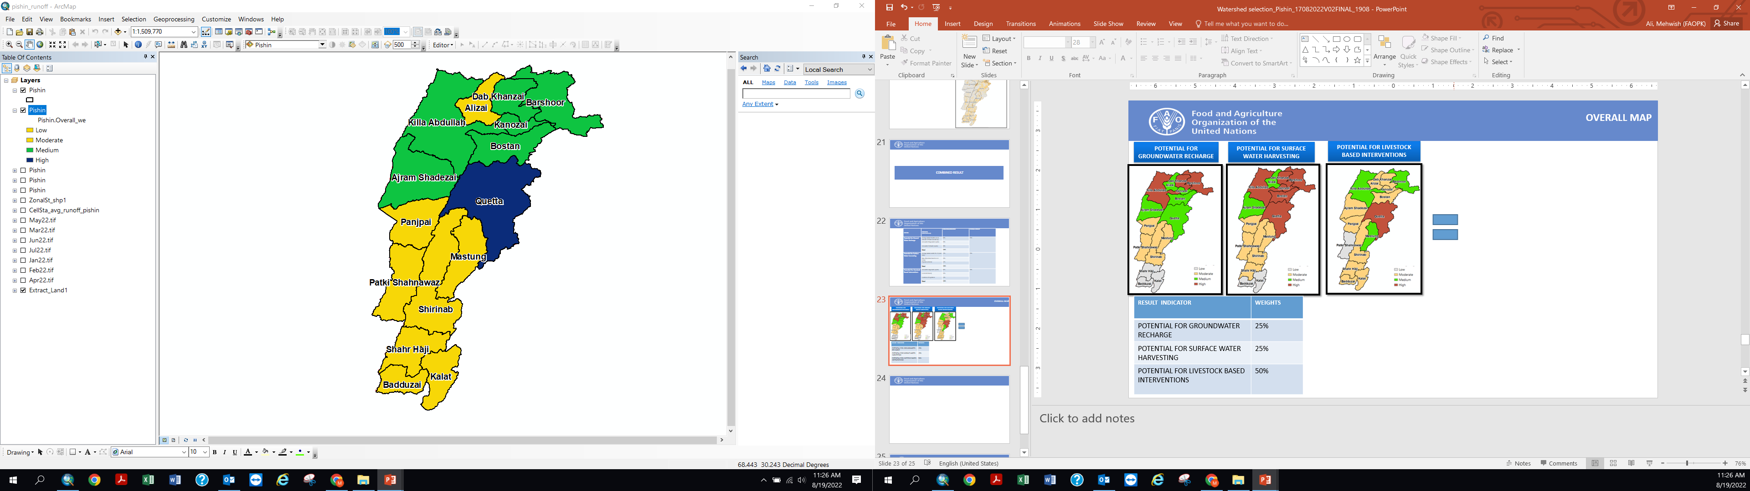
POTENTIAL FOR SURFACE WATER HARVESTING
OVERALL MAP
POTENTIAL FOR
GROUNDWATER RECHARGE
POTENTIAL FOR LIVESTOCK
BASED INTERVENTIONS
RESULT INDICATOR | WEIGHTS
POTENTIAL FOR GROUNDWATER RECHARGE | 25%
POTENTIAL FOR SURFACE WATER HARVESTING | 25%
POTENTIAL FOR LIVESTOCK BASED INTERVENTIONS | 50%

Slide 23
NAME | Score/Rank
Quetta | 3.23
Barshoor | 3.00
Killa Abdullah | 2.95
Dab Khanzai | 2.65
Ajram Shadezai | 2.25
Bostan | 2.23
Kanozai | 2.13
Alizai | 2.00
Mastung | 1.93
Panjpai | 1.73
Shirinab | 1.70
Badduzai | 1.45
Kalat | 1.45
Shahr Haji | 1.25
Patki Shahnawaz | 1.10

Slide 24
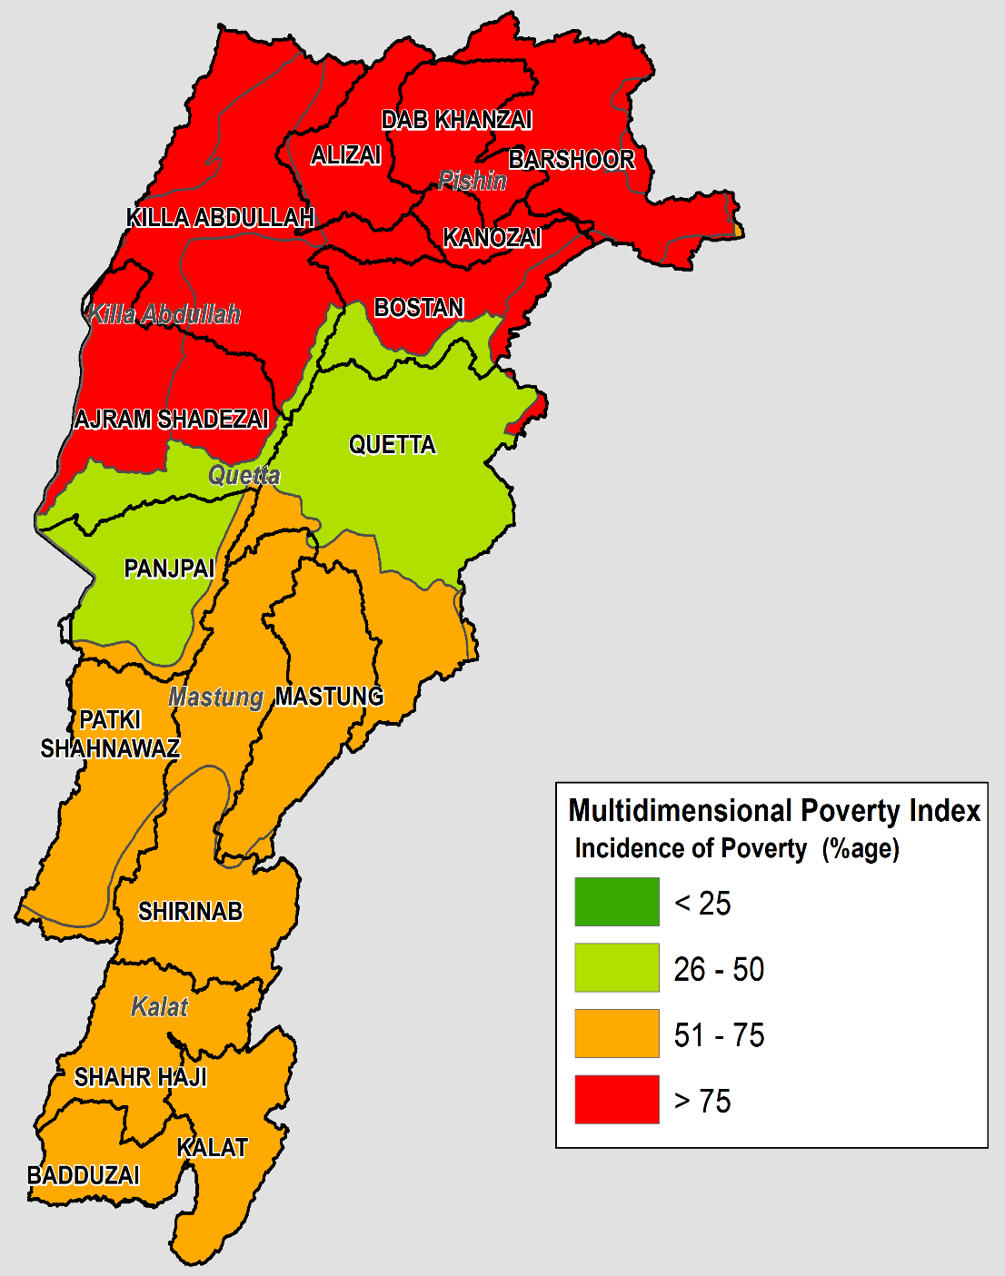
SOCIO-ECONOMIC INDICATORS- BALOCHISTAN
MULTI DIMENSINAL POVERTY INDEX
(Incidence of Poverty % )

Slide 25
Exclusion criteria for disqualification of include one or more of the following:
Areas with relatively low productivity potential for livestock and cropping in comparison to other areas that is % area falling under rugged and rough terrain
Desert and hyper arid areas, (Annual Average Rainfall below 100 mm).
Areas with High Security Risk

Slide 26
THANKYOU FOR YOUR ATTENTION

Slide 27
Exclusion criteria for disqualification of include one or more of the following:
Areas with relatively low productivity potential for livestock and cropping in comparison to other areas that is % area falling under rugged and rough terrain
Desert and hyper arid areas, (Annual Average Rainfall below 100 mm).
Areas with High Security Risk

